Slide 1
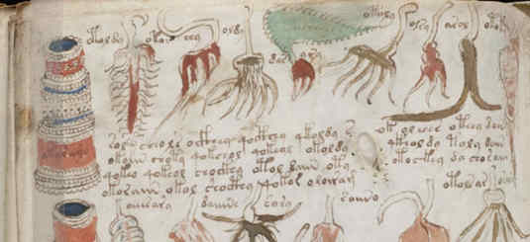
What We Know About the Voynich Manuscript
Kevin Knight
University of Southern California
Sravana Reddy
Dartmouth College
Sources: Mary D’Imperio, The Voynich Manuscript, An Elegant Enigma (1978)
Kennedy & Churchill, The Voynich Manuscript (2006)
Prescott Currier, Some Important New Statistical Findings (1976)
Rene Zandbergen, Currier A and B: Two Different Languages? (1997)
Rene Zandbergen, http://www.voynich.nu/
http://www.voynich.ms/forum/
Cipher Mysteries blog (Nick Pelling)
Knight & Reddy article (2011) in Workshop on Lang. Tech. for Cultural Heritage, Social Sci., and Humanities.
Stanford University
March 2013

Slide 2
Voynich Manuscript (VMS)
Medieval illustrated manuscript
235 pages on vellum material
Color drawings of plants, nymphs, stars, etc.
38,000 words written in an unknown script
Undeciphered!

Slide 3
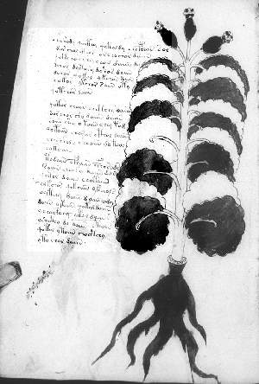
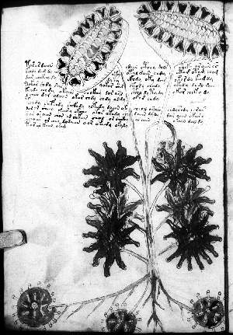
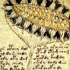
“Herbal” section
Many pictures
look like grafting.
Sunflower? Would date
VMS as post-1492.

Slide 4
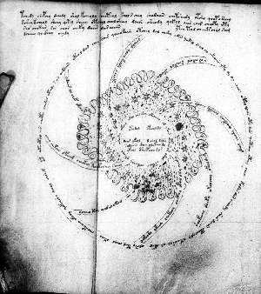
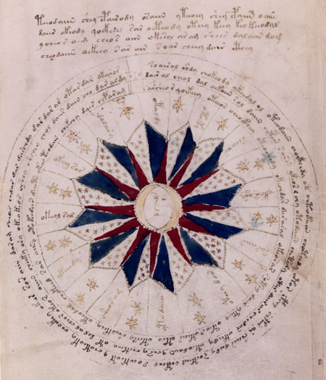
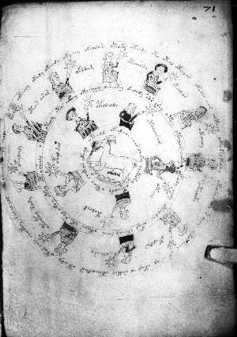
“Astrological” section

Slide 5
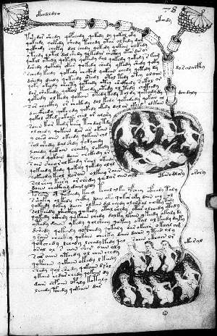
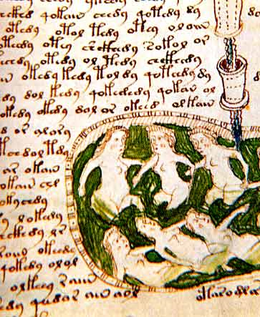
“Biological” section
Small nudes in baths
Interconnecting tubes of liquids

Slide 6
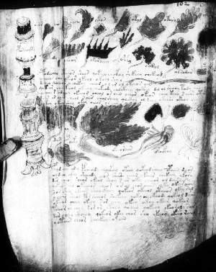
“Pharmacological” section

Slide 7
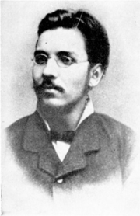
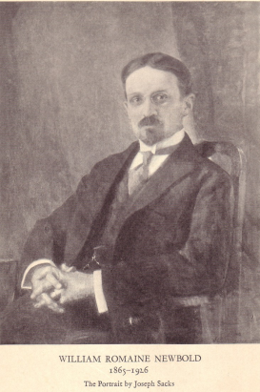
History of Voynich Manuscript
1864 Ethel Boole born in England
1865 WV born in Lithuania
1885 WV imprisoned, Polish nationalist
1890 WV & EB meet, marry in 1902
1898 WV publishes first book list
1912 WV acquires VMS in “ancient castle”
1914 WV moves to USA, opens bookshop
1919 WV sends photostatic copies of VMS
1919 Copying reveals de Tepencz signature
1919 WV writes to Bohemian State Archvs
1921 WV presents VMS + inserted letter
mentioning Francis Bacon, $160k price
1921 Newbold & WV announce decipherment
1930 WV dies. VMS placed in vault, $100k
1931 VMS appraised at $19,400
1960 Ethel dies, VMS to secretary Ann Nill
“Castle” revealed as Villa Mondragone
1961 NY dealer Hans Kraus buys for $24,500
1969 Kraus donates VMS to Yale
1972 Brumbaugh finds WV letters in BSA
200x Zandbergen finds 1639 Baresch letter
in newly online Kircher archive
Wilfrid Michael Voynich
book dealer
William Newbold,
Polymath, PhD UPenn

Slide 8
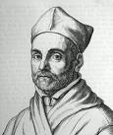

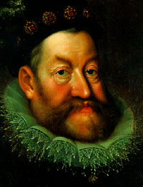
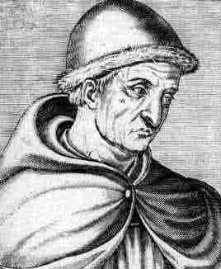
One-Page Letter Tucked Into VMS
Kircher,
super-scholar,
recipient of
this letter
???,
owned VMS
before Marci
Emperor
Rudolf,
paid 600 ducats
for VMS
Roger Bacon
(1214-94)
“first scientist”
Reverend and Distinguished Sir; Father in Christ:
This book bequeathed to me by an intimate friend,
I destined for you, my very dear Athanasius [Kircher],
as soon as it came into my possession, for I was
convinced that it could be read by no one except
yourself. The former owner of this book once asked
your opinion by letter … Accept now this token …
Dr Raphael, tutor in the Bohemian language to
Ferdinand III, then King of Bohemia, told me the said
book had belonged to the Emperor Rudolf and that
he presented the bearer who brought him the book
600 ducats. He believed the author was Roger Bacon,
the Englishman. On this point I suspend judgment …
At the command of your reverence,
Joannes Marcus Marci of Cronland
Prague, 19 August, 1665(6?)

Slide 9
History of Voynich Manuscript
1864 Ethel Boole born in England
1865 WV born in Lithuania
1885 WV imprisoned, Polish nationalist
1890 WV & EB meet, marry in 1902
1898 WV publishes first book list
1912 WV acquires VMS in “ancient castle”
1914 WV moves to USA, opens bookshop
1919 WV sends photostatic copies of VMS
1919 Copying reveals de Tepencz signature
1919 WV writes to Bohemian State Archvs
1921 WV presents VMS + Marci letter
mentioning Bacon, $160k price
1921 Newbold & WV announce decipherment
1930 WV dies. VMS placed in vault, $100k
1931 VMS appraised at $19,400
1960 Ethel dies, VMS to secretary Ann Nill
“Castle” revealed as Villa Mondragone
1961 NY dealer Hans Kraus buys for $24,500
1969 Kraus donates VMS to Yale
1972 Brumbaugh finds WV letters in BSA
200x Zandbergen finds 1639 Baresch letter
in newly online Kircher archive
1576-1612 Rudolf II purchases VMS
1608-1622 J. de Tepenecz signs VMS
in Bohemian court
1630s George Baresch owns VMS
GB sends letter to Kircher
1639 GB writes Kircher again
16xx Marci inherits VMS from GB
1665 Marci sends VMS to Kircher
with letter
1665-80 Kircher owns VMS
1680 Kircher dies
??

Slide 10
History of Voynich Manuscript
1864 Ethel Boole born in England
1865 WV born in Lithuania
1885 WV imprisoned, Polish nationalist
1890 WV & EB meet, marry in 1902
1898 WV publishes first book list
1912 WV acquires VMS in “ancient castle”
1914 WV moves to USA, opens bookshop
1919 WV sends photostatic copies of VMS
1919 Copying reveals Tepenecz signature
1919 WV writes to Bohemian State Archvs
1921 WV presents VMS + Marci letter
mentioning Bacon, $160k price
1921 Newbold & WV announce decipherment
1930 WV dies. VMS placed in vault, $100k
1931 VMS appraised at $19,400
1960 Ethel dies, VMS to secretary Ann Nill
“Castle” revealed as Villa Mondragone
1961 NY dealer Hans Kraus buys for $24,500
1969 Kraus donates VMS to Yale
1972 Brumbaugh finds WV letters in BSA
200x Zandbergen finds 1639 Baresch letter
in newly online Kircher archive
1576-1612 Rudolf II purchases VMS
1608-1622 J. de Tepenecz signs VMS
in Bohemian court
1630s George Baresch owns VMS
GB sends letter to Kircher
1639 GB writes Kircher again
16xx Marci inherits VMS from GB
1665 Marci sends VMS to Kircher
with letter
1665-80 Kircher owns VMS
1680 Kircher dies
??

Slide 11
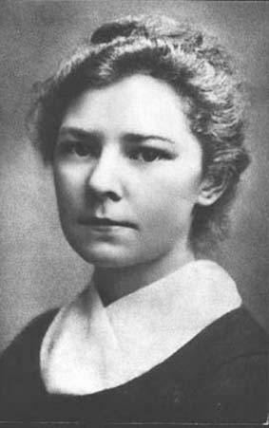


History of Voynich Manuscript
1864 Ethel Boole born in England
1865 WV born in Lithuania
1885 WV imprisoned, Polish nationalist
1890 WV & EB meet, marry in 1902
1898 WV publishes first book list
1912 WV acquires VMS in “ancient castle”
1914 WV moves to USA, opens bookshop
1919 WV sends photostatic copies of VMS
1919 Copying reveals de Tepenecz signature
1919 WV writes to Bohemian State Archvs
1921 WV presents VMS + Marci letter
mentioning Bacon, $160k price
1921 Newbold & WV announce decipherment
1930 WV dies. VMS placed in vault, $100k
1931 VMS appraised at $19,400
1960 Ethel dies, VMS to secretary Ann Nill
“Castle” revealed as Villa Mondragone
1961 NY dealer Hans Kraus buys for $24,500
1969 Kraus donates VMS to Yale
1972 Brumbaugh finds WV letters in BSA
200x Zandbergen finds 1639 Baresch letter
in newly online Kircher archive
??

Slide 12
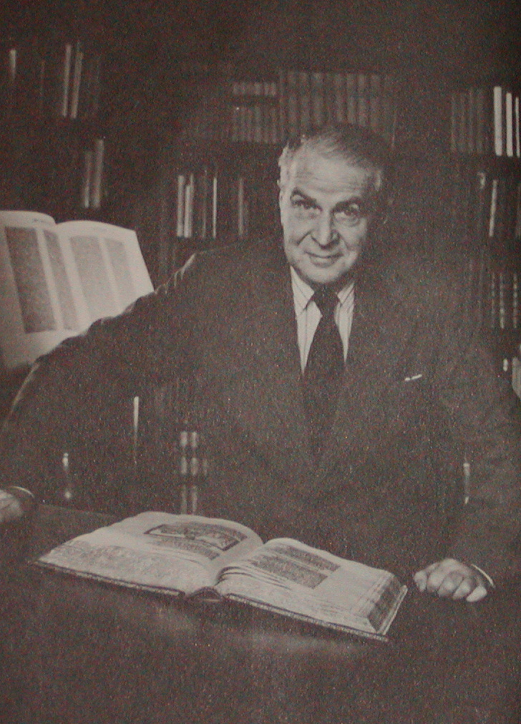
History of Voynich Manuscript
1864 Ethel Boole born in England
1865 WV born in Lithuania
1885 WV imprisoned, Polish nationalist
1890 WV & EB meet, marry in 1902
1898 WV publishes first book list
1912 WV acquires VMS in “ancient castle”
1914 WV moves to USA, opens bookshop
1919 WV sends photostatic copies of VMS
1919 Copying reveals de Tepenecz signature
1919 WV writes to Bohemian State Archvs
1921 WV presents VMS + Marci letter
mentioning Bacon, $160k price
1921 Newbold & WV announce decipherment
1930 WV dies. VMS placed in vault, $100k
1931 VMS appraised at $19,400
1960 Ethel dies, VMS to secretary Ann Nill
“Castle” revealed as Villa Mondragone
1961 NY dealer Hans Kraus buys for $24,500
1969 Kraus donates VMS to Yale
1972 Brumbaugh finds WV letters in BSA
200x Zandbergen finds 1639 Baresch letter
in newly online Kircher archive
??

Slide 13
History of Voynich Manuscript
1864 Ethel Boole born in England
1865 WV born in Lithuania
1885 WV imprisoned, Polish nationalist
1890 WV & EB meet, marry in 1902
1898 WV publishes first book list
1912 WV acquires VMS in “ancient castle”
1914 WV moves to USA, opens bookshop
1919 WV sends photostatic copies of VMS
1919 Copying reveals de Tepenecz signature
1919 WV writes to Bohemian State Archvs
1921 WV presents VMS + Marci letter
mentioning Bacon, $160k price
1921 Newbold & WV announce decipherment
1930 WV dies. VMS placed in vault, $100k
1931 VMS appraised at $19,400
1960 Ethel dies, VMS to secretary Ann Nill
“Castle” revealed as Villa Mondragone
1961 NY dealer Hans Kraus buys for $24,500
1969 Kraus donates VMS to Yale
1972 Brumbaugh finds WV letters in BSA
200x Zandbergen finds 1639 Baresch letter
in newly online Kircher archive
1576-1612 Rudolf II purchases VMS
1608-1622 J. de Tepenecz signs VMS
in Bohemian court
1630s George Baresch owns VMS
GB sends letter to Kircher
1639 GB writes Kircher again
16xx Marci inherits VMS from GB
1665 Marci sends VMS to Kircher
with letter
1665-80 Kircher owns VMS
1680 Kircher dies
“Barschius” owns VMS
between J. de Tepenecz
and Marci
??

Slide 14
History of Voynich Manuscript
1864 Ethel Boole born in England
1865 WV born in Lithuania
1885 WV imprisoned, Polish nationalist
1890 WV & EB meet, marry in 1902
1898 WV publishes first book list
1912 WV acquires VMS in “ancient castle”
1914 WV moves to USA, opens bookshop
1919 WV sends photostatic copies of VMS
1919 Copying reveals de Tepenecz signature
1919 WV writes to Bohemian State Archvs
1921 WV presents VMS + Marci letter
mentioning Bacon, $160k price
1921 Newbold & WV announce decipherment
1930 WV dies. VMS placed in vault, $100k
1931 VMS appraised at $19,400
1960 Ethel dies, VMS to secretary Ann Nill
“Castle” revealed as Villa Mondragone
1961 NY dealer Hans Kraus buys for $24,500
1969 Kraus donates VMS to Yale
1972 Brumbaugh finds WV letters in BSA
200x Zandbergen finds 1639 Baresch letter
in newly online Kircher archive
1576-1612 Rudolf II purchases VMS
1608-1622 J. de Tepenecz signs VMS
in Bohemian court
1630s George Baresch owns VMS
sends letter to Kircher
1639 GB writes Kircher again
16xx Marci inherits VMS from GB
1665 Marci sends VMS to Kircher
with letter
1665-80 Kircher owns VMS
1680 Kircher dies

Slide 15
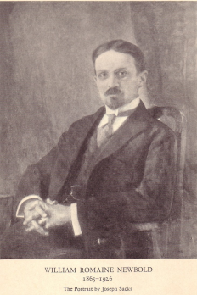
Newbold Decipherment
Marci letter → Bacon → Cabala → “letter doubling” cipher
A B C D E F G H I L M N O P Q R S T U V X Z
A V Z B F G L M N N O …
B C F T U V X …
C F B A Q F C D Z Z …
D
E
F
G
H
I N
L
M A
N
O N
P
Q … …
R
S
T
U … N
V
X
Z
Encoding:
A → CC, OM, …
B → …
…
N → HA, MI, DO, NU …
…
Z → …
Decoding:
…
DO → N
…
22x22 table
Encoder has freedom to devise
a “cover text” to hide real message.
Example:
a n n … → DO MI NU … → DOMINU …

Slide 16
Newbold System
Too hard to assemble good “cover” text!
So, make cipher letter-pairs overlap:
a n n … → AD DB BR … → ADBR …
Then, employ anagramming:
a n n … → OM DO MI … → DO OM MI … → DOMI …
Now can construct a plausible looking “cover” text in Latin for our secret message (also in Latin)
An ingenious system, to be sure!

Slide 17
Newbold Decipherment
Hmm, by the method, both plaintext and ciphertext should be in Latin letters…
But the VMS doesn’t have Latin letters…

Slide 18

… 4OPCC89 …
apparent
ciphertext
P
William Newbold,
Polymath, PhD UPenn

Slide 19
… 4OPCC89 …
apparent
ciphertext
P
William Newbold,
Polymath, PhD UPenn
real
ciphertext:
DOMI…
I
M
O
D

Slide 20

Let’s Decipher with Newbold !
P
real ciphertext
PCC89 …
DOMI…
I
doubling
apparent ciphertext
M
O
DO OM MI …
D
non-deterministic
anagramming
OM DO MI …
lookup in 22² table
a n n …
non-deterministic
mapping from 11
Latin letters to full 22
o n n …

Slide 21
Let’s Decipher with Newbold !
P
real ciphertext
PCC89 …
DOMI…
I
doubling
apparent ciphertext
M
O
DO OM MI …
D
non-deterministic
anagramming
A B C D E F G H I L M N O P Q R S T U V X Z
A V Z B F G L M N N O …
B C F T U V X …
C F B A Q F C D Z Z …
D
E
F
G
H
I N
L
M A
N
O N
P
Q … …
R
S
T
U … N
V
X
Z
OM DO MI …
lookup in 22² table
a n n …
non-deterministic
mapping from 11
Latin letters to full 22
o n n …
22x22 table
(values guessed)

Slide 22
Newbold’s Results
1300 real ciphertext “letters” in first 3 lines
Decipherment of those first lines:
“I, Roger Bacon, have written this…”
(in Latin)
Anagramming sets of 55 letters is sometimes required.
Slow but steady progress… Andromeda galaxy, ovaries … so … Roger Bacon must have had a microscope & telescope, hundreds of years before they were invented … !

Slide 23
whew!
let’s take a step back …

Slide 24
VMS Text
38,000 words
Unknown script
Writing style similar to 15th century Florentine “humanist” hand
Between 23 and 40 distinct characters
No corrections, likely to have been copied
Writing was done after illustrations

Slide 25
Transcription
BSC8AE OPCC9 4OE FCC89 4OFCC9 4OP9 SCBS9 4OBSC9 EFAM OPAE29
2ZC9 4OFC89 4OFAM Z89 4OFCC9 SC89 4OFCC9 4OFCC9 ESC89 EOP9
8ZC9 4OPCCC9 8ARSC89 4OFC9 4OP9
BSC8AE OPCC9 4OE FCC89 4OFCC9 4OP9 SCBS9 4OBSC9 EFAM OPAE29
2ZC9 4OFC89 4OFAM Z89 4OFCC9 SC89 4OFCC9 4OFCC9 ESC89 EOP9
8ZC9 4OPCCC9 8ARSC89 4OFC9 4OP9
last paragraph, f103r

Slide 26
Alphabet: Currier/D’Imperio Transcription
C S Z
C S Z
P F B V
P F B V
Q X W Y
Q X W Y
J A E R O I D
J A E R O I D
6 7 8 9 4 2
6 7 8 9 4 2
G H 1
G H 1
T U 0
T U 0
N M 3
N M 3
K L 5
K L 5

Slide 27
Alphabet: Currier/D’Imperio Transcription
C S Z
C S Z
P F B V
P F B V
Q X W Y
Q X W Y
J A E R O I D
J A E R O I D
6 7 8 9 4 2
6 7 8 9 4 2
G H 1
G H 1
T U 0
T U 0
Maybe this is really
IR IIR IIIR
There are several transcription
schemes to choose from.

Slide 28
Alphabet: Currier/D’Imperio Transcription
C S Z
C S Z
Variations of Z , or separate characters?
S S S S S S

Slide 29
Alphabet: Currier/D’Imperio Transcription
C S Z
C S Z
P F B V
P F B V
Q X W Y
Q X W Y
Are these ligatures?
Is Q just a fancy way of writing SP ?
If you didn’t know English, how would you know if was the same as ?
Suppose never occurred. Would that be evidence?
Suppose did occur, with the same contexts as (e.g., *shing)?
Suppose did occur, but never in the same context as ?
Another common motif:
fi
f i
f i
f i
fi
f i
fi
SOORSOE9S9

Slide 30
Letter Frequencies
count letter
count letter
count letter
O C 9 A 8 S E F R P 4 Z M
2886 2
1752 N
1413 B
1046 J
950 Q
908 X
591 T
524 *
431 V
316 I
217 W
157 D
156 3
2 N B J Q X T * V I W D 3
U 6 Y K G L H 1 5 0
25468 O
20227 C
17655 9
14281 A
12973 8
11008 S
10471 E
10026 F
6716 R
5994 P
5423 4
4501 Z
4076 M
148 U
96 6
74 Y
52 K
31 G
17 L
14 H
2 1
1 5
1 0
Total
63k character tokens

Slide 31
Most Frequent “Words”
count word
count word
count word
863 8AM
537 OE
501 SC89
469 AM
426 ZC89
396 SOE
363 OR
350 AR
344 SC9
318 8AR
308 4OFCC9
305 4OFCC89
283 ZC9
279 4OFAN
272 4OFC89
270 89
262 4OFAM
260 AE
253 8AE
243 2
219 SOR
8AM OE SC89 AM ZC89 SOE OR AR SC9 8AR 4OFCC9 4OFCC89 ZC9 4OFAN 4OFC89 89 4OFAM AE 8AE 2 SOR
212 OFAM
211 8AN
191 4OFAE
186 ZOE
177 OFCC9
174 SCC9
172 SCOE
155 S9
155 OPC89
154 OPAM
152 4OFAR
151 9
151 4OE
150 S89
147 4OF9
144 ZCC9
144 OFAN
144 2AM
143 OPAE
141 OPAR
140 SX9
OFAM 8AN 4OFAE ZOE OFCC9 SCC9 SCOE S9 OPC89 OPAM 4OFAR 9 4OE S89 4OF9 ZCC9 OFAN 2AM OPAE OPAR SX9
140 OPCC9
138 OFAE
130 ZO
129 OFAR
119 ESC89
118 OFC89
OPCC9 OFAE ZO OFAR ESC89 OFC89
etc
Total:
8116 distinct words

Slide 32
Word Repeats
115 (out of 8116) distinct words appear doubled at least once
… 4OFCC89 4OFCC89 …
8 distinct words appear tripled
… 4OFC89 4OFC89 4OFC89 …
… SOE SOE SOE …
… ZCOE ZCOE ZCOE …
… OFAM OFAM OFAM …
… OE OE OE …
… 9PAM 9PAM 9PAM …
… 8AM 8AM 8AM …
… 4OFCC89 4OFCC89 4OFCC89 …

Slide 33
Cryptogram Theory
Newbold (1921)
Manly (1931), critique of Newbold
Feely (1945), abbreviated Latin
Strong (1945), polyalphabetic cipher
no details given, for national security reasons
Brumbaugh (1972), numerological box
Several attempts in the 1990s
1-for-n substitution (4OFC89 → anno)

Slide 34
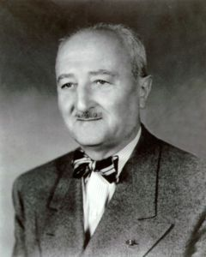
Theory of William Freidman
Most famous American cryptographer of World War II
VMS Study Group (1944-46)
developed transcription alphabet
group disbanded after the war
2nd VMS Study Group (1962)
at RCA
His ultimate theory:
VMS written in a synthetic “philosophical” language

Slide 35
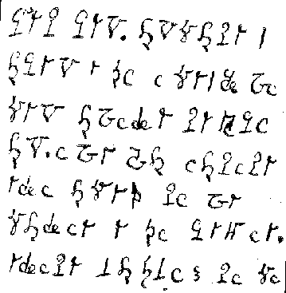
Writing in Tongues?
suggested in Kennedy & Churchill, 2005
Historical example:
Medium Helene Smith, investigated by Theodore Flournoy (1896)
Under a trance, Smith was able to converse with Martians
She learned their language and could speak and write it
Grammar closer to French than you might expect
Smith’s Martian

Slide 36
Hoax?
Previous hoaxes:
Hitler diaries
Vinland map
Carbon dating (reported 2011)
Done at University of Arizona
Four page fragments, each 1x6mm
Result: 1404-1438 (w/ 95% probability)*
Ink pigments consistent with that

Slide 37
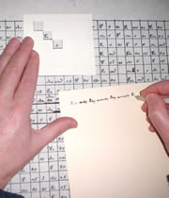
Gordon Rugg Theory (Scientific American, 2004)
Proposed Cardan grille
Elizabethan cryptography tool
If applied with randomness injected, claimed to generate VMS-like text

Slide 38
Substitution Cipher
ingcmpnqsnwf cv fpn owoktvcv
hu ihgzsnwfv rqcffnw cw owgcnwf
kowazoanv ...

Slide 39
Substitution Cipher
e e e e
ingcmpnqsnwf cv fpn owoktvcv
e e e
hu ihgzsnwfv rqcffnw cw owgcnwf
e
kowazoanv ...

Slide 40
Substitution Cipher
e e e the
ingcmpnqsnwf cv fpn owoktvcv
e e e
hu ihgzsnwfv rqcffnw cw owgcnwf
e
kowazoanv ...

Slide 41
Substitution Cipher
e he e the
ingcmpnqsnwf cv fpn owoktvcv
e e e t
hu ihgzsnwfv rqcffnw cw owgcnwf
e
kowazoanv ...

Slide 42
Substitution Cipher
e he e of the
ingcmpnqsnwf cv fpn owoktvcv
e e e t
hu ihgzsnwfv rqcffnw cw owgcnwf
e
kowazoanv ...

Slide 43
Substitution Cipher
e he e of the fof
ingcmpnqsnwf cv fpn owoktvcv
e f o e o oe t
hu ihgzsnwfv rqcffnw cw owgcnwf
ef
kowazoanv ...

Slide 44
Substitution Cipher
e he e of the
ingcmpnqsnwf cv fpn owoktvcv
e e e t
hu ihgzsnwfv rqcffnw cw owgcnwf
e
kowazoanv ...

Slide 45
Substitution Cipher
e he e is the sis
ingcmpnqsnwf cv fpn owoktvcv
e s i e i ie t
hu ihgzsnwfv rqcffnw cw owgcnwf
es
kowazoanv ...

Slide 46
Substitution Cipher
Pattern Words
abacdefb ACADEMIC
abacdefb DEDICATE
abacdefb MEMBRANE
abacdefc ELECTRIC
abacdefc TUTELAGE
abacdefd ANARCHIC
abacdefd EVERYDAY
abacdefe ANALYSES
abacdefe ANALYSIS
abacdeff EYEGLASS
e he e is the sis
ingcmpnqsnwf cv fpn owoktvcv
e s i e i ie t
hu ihgzsnwfv rqcffnw cw owgcnwf
es
kowazoanv ...

Slide 47
Pattern Words
abacdefb ACADEMIC
abacdefb DEDICATE
abacdefb MEMBRANE
abacdefc ELECTRIC
abacdefc TUTELAGE
abacdefd ANARCHIC
abacdefd EVERYDAY
abacdefe ANALYSES
abacdefe ANALYSIS
abacdeff EYEGLASS
Substitution Cipher
decipherment is the analysis
ingcmpnqsnwf cv fpn owoktvcv
of documents written in ancient
hu ihgzsnwfv rqcffnw cw owgcnwf
languages ...
kowazoanv ...

Slide 48
Computer Decipherment
Train on Spanish web text.
Parameters fixed.
Spanish letter trigram model
Probabilistic model that
substitutes VMS letters for Latin
letters. Initially uniform.
q u o _ v a d e _ b r e r t e _ …
a → {all Voynich letters}
b → {all Voynich letters}
c → {all Voynich letters}
…
z → {all Voynich letters}
_ → _
EM Algorithm.
argmax P(VMS) = argmax Σ P(latin) P(VMS | Latin)
θ θ latin
EM method demonstrated on many decipherment tasks [Knight et al 2006].
V A S 9 2 _ 9 F A E _ A R _ A P A M _ …

Slide 49
Substitution Cipher
Input | Best decipherment, assuming plaintext is Spanish
cevzren cnegr qry vatravbfb uvqnytb qba dhvwbgr qr yn znapun … | primera parte del ingenioso hidalgo don quijote de la mancha …
VAS92 9FAE AR APAM ZOE ZOR9 QOR92 9 FOR ZOE89 … | decos acho es imen des dena denal y des denta …
Or if plaintext is assumed to be Latin:
quiss squm is onum pom
quss hates s qum hatis …

Slide 50
80+ Plaintext Languages
Input | Best guess of plaintext language | Best decipherment
cevzren cnegr qry vatravbfb uvqnytb qba dhvwbgr qr yn znapun … | Spanish | primera parte del ingenioso hidalgo don quijote de la mancha …
VAS92 9FAE AR APAM ZOE ZOR9 QOR92 9 FOR ZOE89 … | ??? Romanian ??? | nonsense

Slide 51
Consonantal Writing
Input | Best guess of plaintext language | Best decipherment
ceze ceg qy ataf uqyt qa dwg q y zapu … | Spanish | prmr prt dl ngns hdlg dn qvt d l mnch …
VAS92 9FAE AR APAM ZOE ZOR9 QOR92 9 FOR ZOE89 … | more nonsense!

Slide 52
Unsupervised Letter Clustering
Initially uniform
Trigram model over {a, b, _ }
a a _ b a b _ a b a a _ …
a → {all English letters}
b → {all English letters}
_ → _
i n _ t h e _ t o w n _ w h e r e _ i _ was …

Slide 53

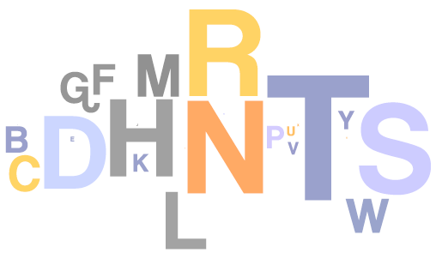
Unsupervised Letter Clustering
Initially uniform
Trigram model over {a, b, _ }
a a _ b a b _ a b a a _ …
a →
b →
_ → _
Sample tagging with learned model:
a b _ b b a _ b a b b _
i n _ t h e _ t o w n _
b b a b a _ a _ …
w h e r e _ i _ …
i n _ t h e _ t o w n _ w h e r e _ i _ was …

Slide 54
Unsupervised Letter Clustering
Initially uniform
Trigram model over {a, b, _ }
a a _ b a b _ a b a a _ …
?
a → {all Voynich letters}
b → {all Voynich letters}
_ → _
Sample tagging with learned model:
? ? ? ? ? _ ? ? ? ? _ ? ? _
V A S 9 2 _ 9 F A E _ A R _
? ? ? ? _ ? ? ? _ ? ? ? ? _ …
A P A M _ Z O E _ Z O R 9 _ …
?
V A S 9 2 _ 9 F A E _ A R _ A P A M _ …

Slide 55
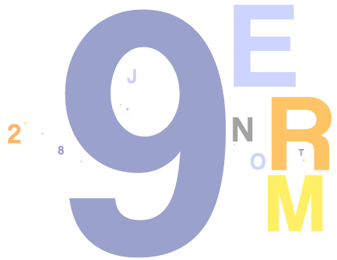
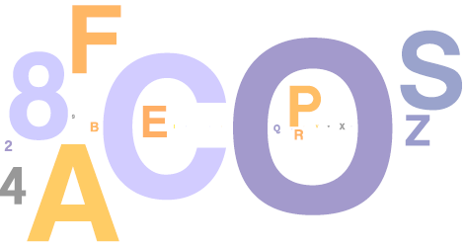
Unsupervised Letter Clustering
Initially uniform
Trigram model over {a, b, _ }
a a _ b a b _ a b a a _ …
a →
b →
_ → _
Sample tagging with learned model:
b b b b a _ a b b a _ b a _
V A S 9 2 _ 9 F A E _ A R _
b b b a _ b b a _ b b b a _ …
A P A M _ Z O E _ Z O R 9 _ …
V A S 9 2 _ 9 F A E _ A R _ A P A M _ …

Slide 56
Unsupervised Letter Clustering
P(letter | tag)
P(tag | letter)
a →
b →
P(a)
English
P(a)
a →
b →
Voynich

Slide 57
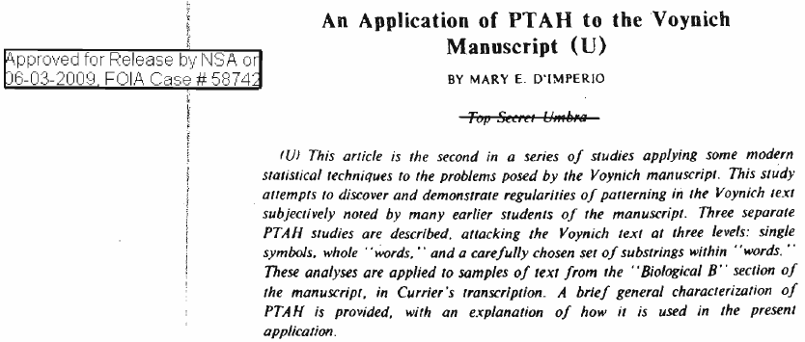
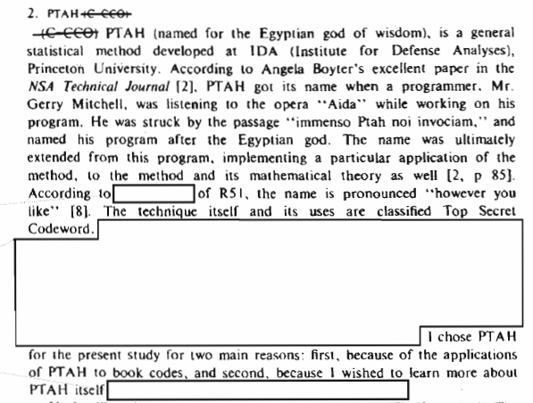
1970s NSA report
recently declassified!

Slide 58
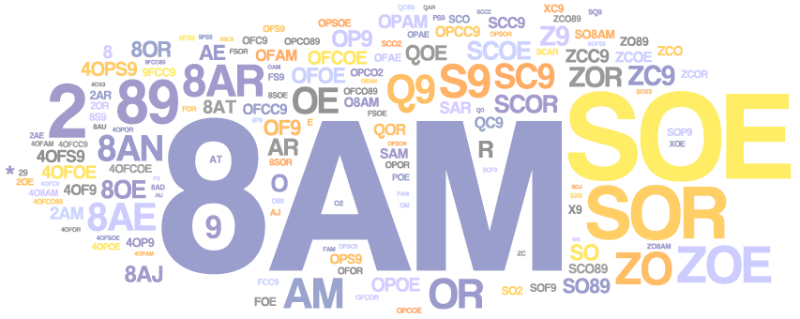
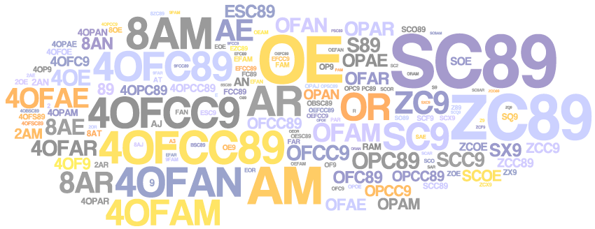
Word Clustering
Bigram model over {a, b}
Do words with similar contexts
have similar spellings?!
That would be very interesting.
a a b a b a b a a …
a →
b →
VAS92 9FAE AR APAM ZOE ZOR9 QRC2 9 ...

Slide 59
Word Clustering
Bigram model over {a, b}
Do words with similar contexts
have similar spellings?!
That would be very interesting.
a a b a b a b a a …
a →
b →
Sample tagging with learned model:
a a a a a a
VAS92 9FAE AR APAM ZOE ZOR9
a a a a a …
QRC2 9 FOR ZOE89 2OR9 …
WAIT,
WHAT?
VAS92 9FAE AR APAM ZOE ZOR9 QRC2 9 ...

Slide 60
Word Clustering
Voynich words tagged as “a”
← pages →
Voynich words tagged as “b”

Slide 61
Word Clustering
Voynich words tagged as “a”
← pages →
Voynich words tagged as “b”

Slide 62
Word Clustering
Voynich words tagged as “a”
← pages →
Voynich words tagged as “b”
Herbal
Astro
Bio
Pharma
Stars
Known since Capt. Currier’s analysis (1976)

Slide 63
Statistical Analysis of Voynich B
Since there are two distinct languages, we focus analysis on one of them (Bio and Stars)
Ask some basic questions about the “linguistic” structure
The Page
The Line
The Word

Slide 64
The PAGE

Slide 65
Can we identify content words and function words?
Some pages are missing, but the current version comprises about 240 vellum pages, most with illustrations. Much of the manuscript resembles herbal manuscripts of the 1500s, seeming to present illustrations and information about plants and their possible uses for medical purposes.

Slide 66
Can we identify content words and function words?
Measure the saliency of a word in a page with TF-IDF
# times that word w occurs in page d
# pages that contain word w

Slide 67
Can we identify content words and function words?

Slide 68
Can we identify content words and function words?
As a control: Scramble words across text and repaginate

Slide 69
Do the content words indicate topics?

Slide 70
Content words and function words
Conclusion:
Some words are “bursty” within a page or groups of pages, other words are more uniformly distributed across the manuscript

Slide 71
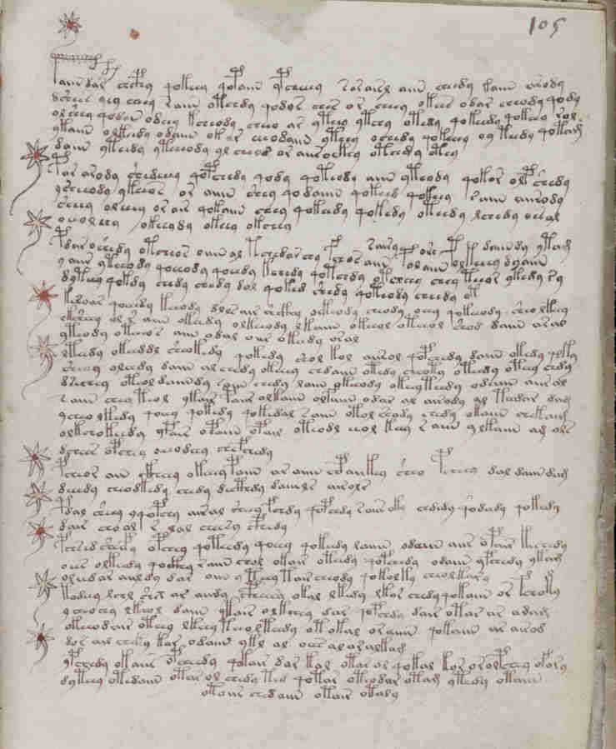
Are the pages in order?
Numbers were added by later owners.
What can the text tell us about the manuscript’s page order?
Notes:
Do as a continuation of
Zandbergen’s plot

Slide 72
Are the pages in order?
Measure similarity between a pair of pages using cosine similarity (with bag-of-words)
Count the % of pages P where the most similar page to P is adjacent to it

Slide 73
The Line

Slide 74
Is the text prose?
Paragraph structure
Special ligatures at beginning of “paragraphs”

Slide 75
Is the text prose?
Characters that begin a word token
Characters that begin a line

Slide 76
Is the text prose?
Characters that end a word token
Characters that end a line

Slide 77
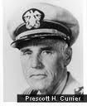
Is the text prose?
Conclusion:
Lines begin and end disproportionately often with certain characters
The line is a functional entity…

Slide 78
How predictable are word sequences?
Guess most likely word to follow current word
Simulate game from bigram probabilities 90-10 train-test splits

Slide 79
Are there collocations?
Measure ‘collocationness’ with mutual information
Probability of word x and word y co-occurring at a fixed distance apart

Slide 80
Are there collocations?
Cruise Lines, blood cell, privately funded, several hundred, Wall Street
Alfred Knopf, Wall Journal, Neither nor
one-year mortgages, former mayor, At time
emissions acid, entitles buy, couldn’t comment

Slide 81
Are there collocations?

Slide 82
Are there collocations?
Conclusion:
Weak adjacent-word collocations
No long-range collocations

Slide 83
The Word

Slide 84
Word length distribution
Notes:
Put the vowels and consonants here

Slide 85
Word-internal structure
Repeat predictability simulation with letters (including spaces)

Slide 86
Conclusion
Voynich Manuscript
What it is → pretty clear
Where it came from → still many theories
What it means → totally unclear
Lots more room for computer techniques:
Transcription
Determining relations between words and pictures
Identification of “topics”
More unsupervised pattern finding

Slide 87
thanks!

Slide 88
backup

Slide 89
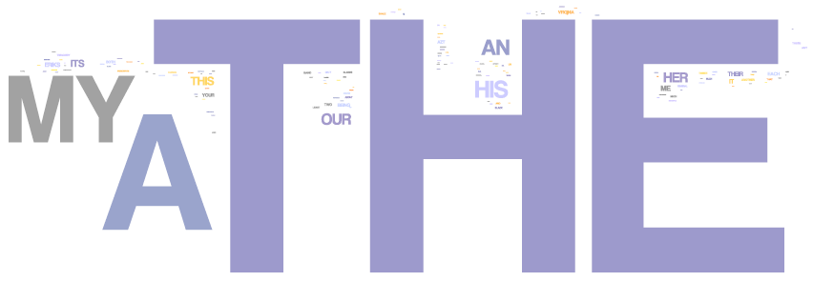
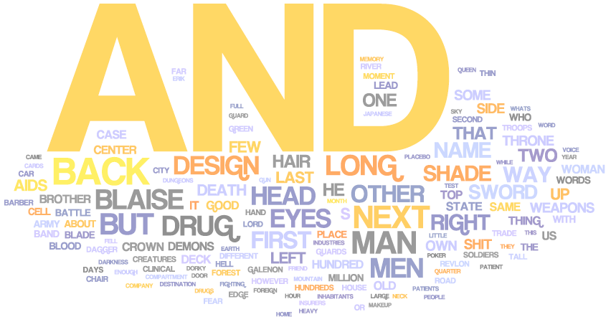
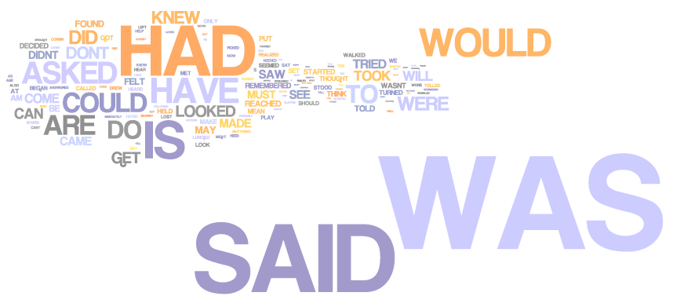
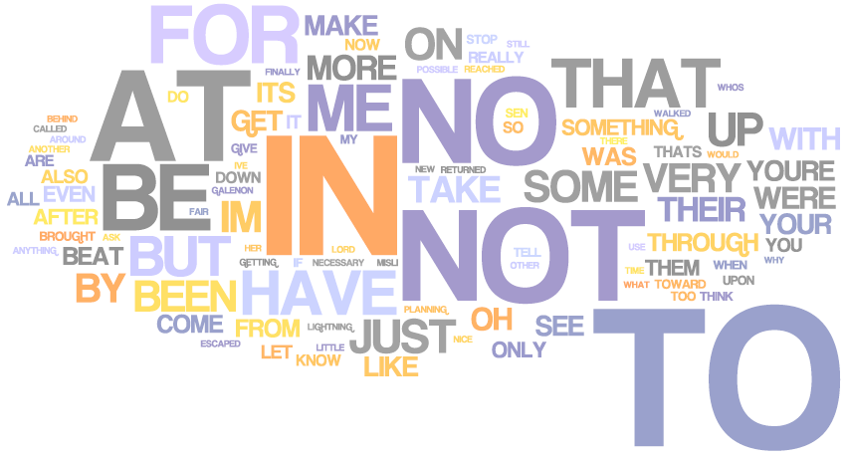
10 clusters: English
etc
etc
etc
etc
etc
etc

Slide 90
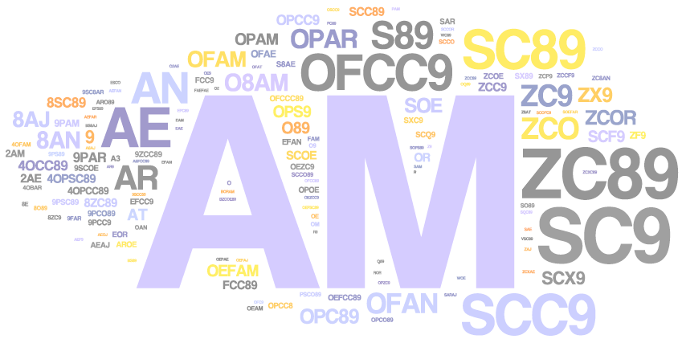
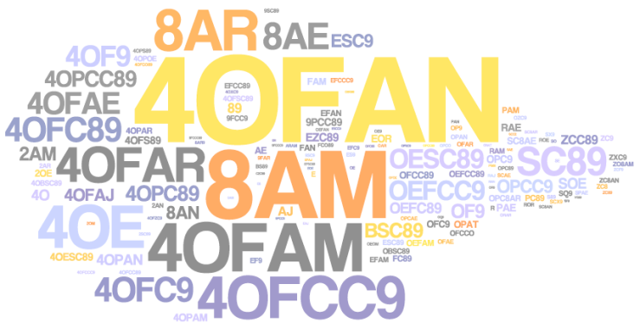
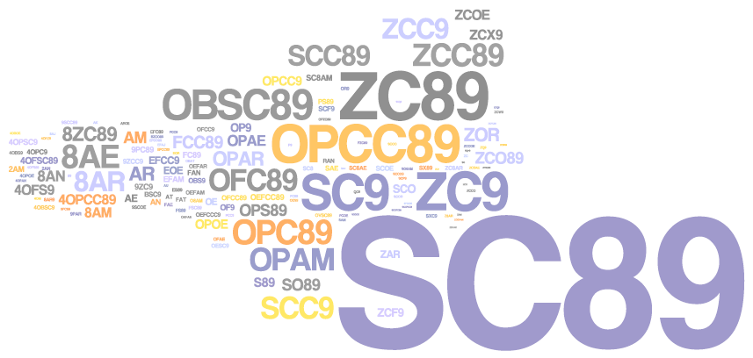
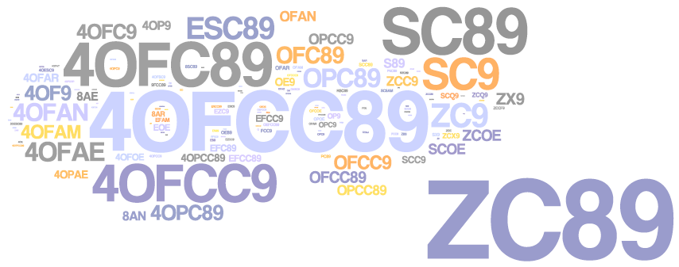
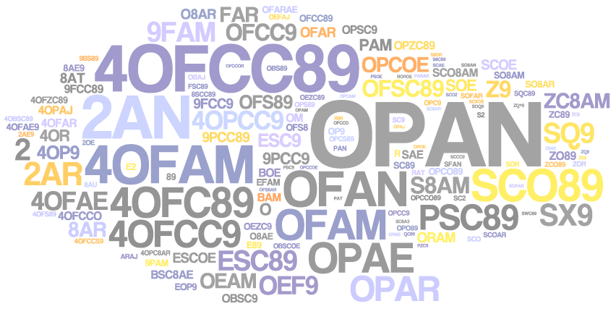
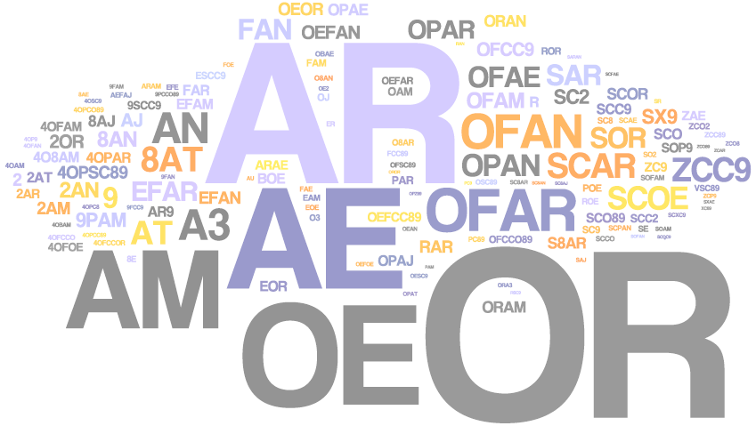
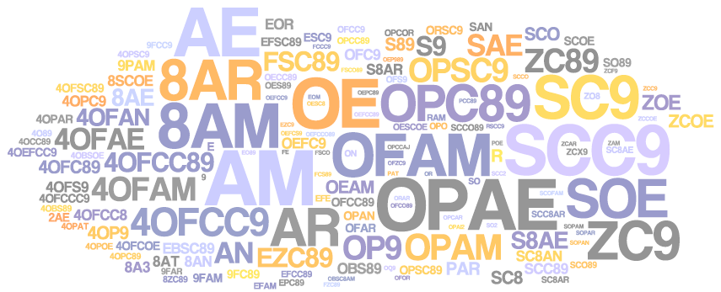
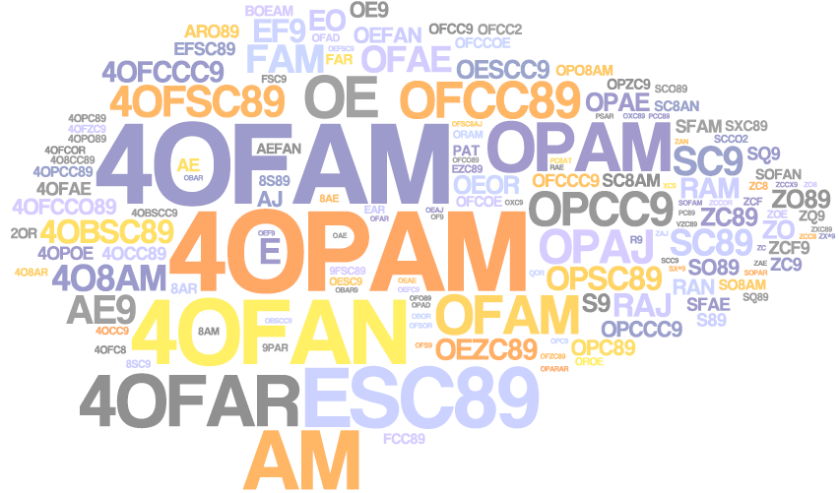
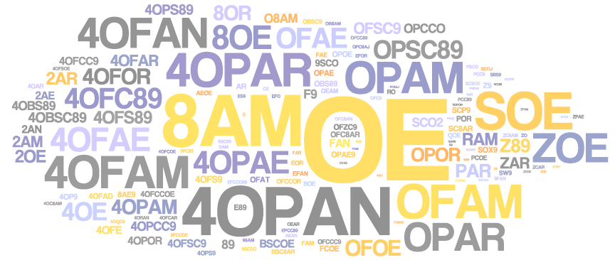
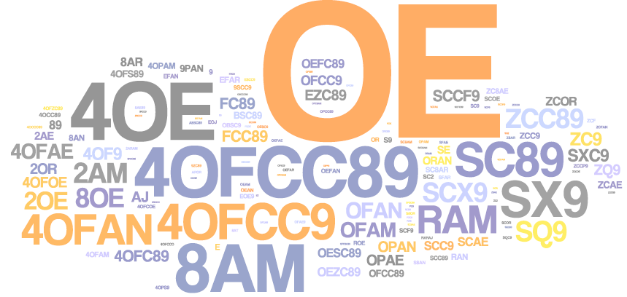
a
b
d
10-class
tagging of
Voynich-B
c
f
e
g
h
i
j

Slide 91
10 clusters: Voynich-B
Tags per
page.

Slide 92
10 clusters: Voynich-B
Tags per
page.
“Bio” words vs.
“Stars” words

